Slide 1
Why Cloud Computing (CC)?
Cloud computing is the delivery of different services through the Internet. These resources include tools and applications like data storage, servers, databases, networking, and software.
Cloud computing is a popular option for people and businesses for a number of reasons including cost savings, increased productivity, speed and efficiency, performance, and security.

Slide 2
Different Perspectives on CC
Cloud computing is named as such because the information being accessed is found remotely in the cloud or a virtual space. Companies that provide cloud services enable users to store files and applications on remote servers and then access all the data via the Internet.
Businesses can employ cloud computing in different ways. Some users maintain all apps and data on the cloud, while others use a hybrid model, keeping certain apps and data on private servers and others on the cloud.
When it comes to providing services, the big players in the corporate computing sphere include:
Google Cloud
Amazon Web Services (AWS)
Microsoft Azure
IBM Cloud
Alibaba Cloud

Slide 3
Different Stakeholders in CC
NIST Cloud Computing reference architecture defines five major performers:
Cloud Provider
Cloud Carrier
Cloud Broker
Cloud Auditor
Cloud Consumer

Slide 4
National Institute of Standards and Technology (NIST)
The National Institute of Standards and Technology (NIST) is a physical sciences laboratory and non-regulatory agency of the United States Department of Commerce.
Its mission is to promote American innovation and industrial competitiveness.
NIST's activities are organized into laboratory programs that include nanoscale science and technology, engineering, information technology, neutron research, material measurement, and physical measurement.
From 1901 to 1988, the agency was named the National Bureau of Standards

Slide 5
Cloud Service Providers
IaaS Providers: In this model, the cloud service providers offer infrastructure components that would exist in an on-premises data center. These components consist of servers, networking, and storage as well as the virtualization layer.
PaaS Providers: In Platform as a Service (PaaS), vendors offer cloud infrastructure and services that can access to perform many functions. In PaaS, services and products are mostly utilized in software development. PaaS providers offer more services than IaaS providers. PaaS providers provide operating system and middleware along with application stack, to the underlying infrastructure.
SaaS Providers: In Software as a Service (SaaS), vendors provide a wide sequence of business technologies, such as Human resources management (HRM) software, customer relationship management (CRM) software, all of which the SaaS vendor hosts and provides services through the internet.

Slide 6
Cloud Carrier
The mediator who provides offers connectivity and transport of cloud services within cloud service providers and cloud consumers.
It allows access to the services of the cloud through Internet networks, telecommunication, and other access devices.
Network and telecom carriers or a transport agent can provide distribution.
A consistent level of services is provided when cloud providers set up Service Level Agreements (SLA) with a cloud carrier. In general, Carrier may be required to offer dedicated and encrypted connections.

Slide 7
Cloud Broker
An organization or a unit that manages the performance, use, and delivery of cloud services by enhancing specific capability and offers value-added services to cloud consumers. It combines and integrates various services into one or more new services. They provide service arbitrage which allows flexibility and opportunistic choices. There are major three services offered by a cloud broker:
Service Intermediation.
Service Aggregation.
Service Arbitrage.

Slide 8
Cloud Auditor
An entity that can conduct independent assessment of cloud services, security, performance, and information system operations of the cloud implementations. The services that are provided by Cloud Service Providers (CSP) can be evaluated by service auditors in terms of privacy impact, security control, and performance, etc. Cloud Auditor can make an assessment of the security controls in the information system to determine the extent to which the controls are implemented correctly, operating as planned and constructing the desired outcome with respect to meeting the security necessities for the system. There are three major roles of Cloud Auditor which are mentioned below:
Security Audit.
Privacy Impact Audit.
Performance Audit.

Slide 9
Cloud Consumer
A cloud consumer is the end-user who browses or utilizes the services provided by Cloud Service Providers (CSP), sets up service contracts with the cloud provider.
The cloud consumer pays peruse of the service provisioned. Measured services utilized by the consumer.
In this, a set of organizations having mutual regulatory constraints performs a security and risk assessment for each use case of Cloud migrations and deployments.

Slide 10
Total cost of ownership (TCO)
The Total Cost of Ownership (TCO) for enterprise software is the sum of all direct and indirect costs incurred by that software, and is a critical part of the ROI calculation.
The total cost of ownership (TCO) is used to calculate the total cost of purchasing and operating a technology product or service over its useful life. The TCO is important for evaluating technology costs that aren't always reflected in upfront pricing.

Slide 11
Characteristics of cloud computing
On-demand self-services: The Cloud computing services does not require any human administrators, user themselves are able to provision, monitor and manage computing resources as needed.
Broad network access: The Computing services are generally provided over standard networks and heterogeneous devices.
Rapid elasticity: The Computing services should have IT resources that are able to scale out and in quickly and on as needed basis. Whenever the user require services it is provided to him and it is scale out as soon as its requirement gets over.
Resource pooling: The IT resource (e.g., networks, servers, storage, applications, and services) present are shared across multiple applications and occupant in an uncommitted manner. Multiple clients are provided service from a same physical resource.
Measured service: The resource utilization is tracked for each application and occupant, it will provide both the user and the resource provider with an account of what has been used. This is done for various reasons like monitoring billing and effective use of resource

Slide 12
Vision of Cloud Computing
Cloud computing provides the facility to provision virtual hardware, runtime environment and services to a person having money.
These all things can be used as long as they are needed by the user.
The whole collection of computing system is transformed into collection of utilities, which can be provisioned and composed together to deploy systems in hours rather than days, with no maintenance cost.
The long term vision of a cloud computing is that IT services are traded as utilities in an open market without technological and legal barriers.

Slide 13
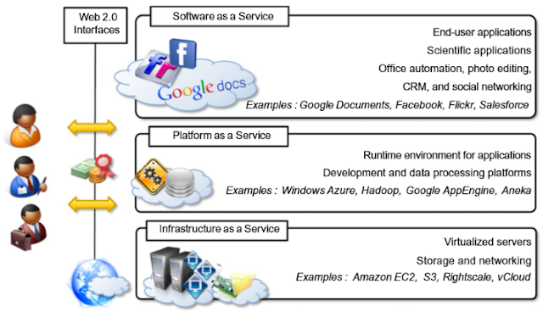
Cloud Computing Reference Model

Slide 14
Cloud Computing Challenges
Security and Privacy: Security and Privacy of information is the biggest challenge to cloud computing. Security and privacy issues can be overcome by employing encryption, security hardware and security applications.
Portability: This is another challenge to cloud computing that applications should easily be migrated from one cloud provider to another. There must not be vendor lock-in. However, it is not yet made possible because each of the cloud provider uses different standard languages for their platforms.
Interoperability: It means the application on one platform should be able to incorporate services from the other platforms. It is made possible via web services, but developing such web services is very complex.
Computing Performance: Data intensive applications on cloud requires high network bandwidth, which results in high cost. Low bandwidth does not meet the desired computing performance of cloud application.
Reliability and Availability: It is necessary for cloud systems to be reliable and robust because most of the businesses are now becoming dependent on services provided by third-party.

Slide 15
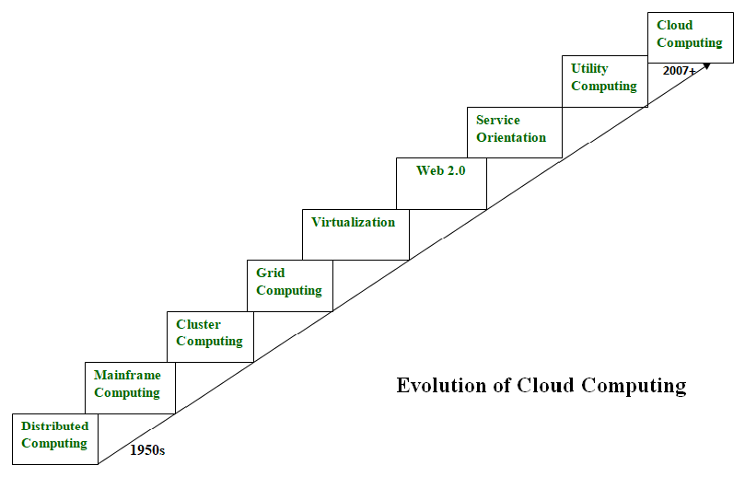
Evolution of Cloud Computing

Slide 16
Distributed Systems
It is a composition of multiple independent systems but all of them are depicted as a single entity to the users.
The purpose of distributed systems is to share resources and also use them effectively and efficiently.
Distributed systems possess characteristics such as scalability, concurrency, continuous availability, heterogeneity, and independence in failures.
But the main problem with this system was that all the systems were required to be present at the same geographical location.
Thus to solve this problem, distributed computing led to three more types of computing and they were-Mainframe computing, cluster computing, and grid computing.

Slide 17
Mainframe computing
Mainframes which first came into existence in 1951 are highly powerful and reliable computing machines.
These are responsible for handling large data such as massive input-output operations.
Even today these are used for bulk processing tasks such as online transactions etc.
These systems have almost no downtime with high fault tolerance. After distributed computing, these increased the processing capabilities of the system.
But these were very expensive. To reduce this cost, cluster computing came as an alternative to mainframe technology.

Slide 18
Cluster computing
In 1980s, cluster computing came as an alternative to mainframe computing.
Each machine in the cluster was connected to each other by a network with high bandwidth.
These were way cheaper than those mainframe systems.
These were equally capable of high computations.
Also, new nodes could easily be added to the cluster if it was required.
Thus, the problem of the cost was solved to some extent but the problem related to geographical restrictions still pertained.
To solve this, the concept of grid computing was introduced.

Slide 19
Grid computing
In 1990s, the concept of grid computing was introduced.
It means that different systems were placed at entirely different geographical locations and these all were connected via the internet.
These systems belonged to different organizations and thus the grid consisted of heterogeneous nodes.
Although it solved some problems but new problems emerged as the distance between the nodes increased.
The main problem which was encountered was the low availability of high bandwidth connectivity and with it other network associated issues.
Thus. cloud computing is often referred to as “Successor of grid computing”.

Slide 20
Virtualization
It was introduced nearly 40 years back.
It refers to the process of creating a virtual layer over the hardware which allows the user to run multiple instances simultaneously on the hardware.
It is a key technology used in cloud computing.
It is the base on which major cloud computing services such as Amazon EC2, VMware vCloud, etc work on.
Hardware virtualization is still one of the most common types of virtualization.

Slide 21
Web 2.0
It is the interface through which the cloud computing services interact with the clients.
It is because of Web 2.0 that we have interactive and dynamic web pages. It also increases flexibility among web pages.
Popular examples of web 2.0 include Google Maps, Facebook, Twitter, etc. Needless to say, social media is possible because of this technology only.
In gained major popularity in 2004.

Slide 22
Service orientation
It acts as a reference model for cloud computing.
It supports low-cost, flexible, and evolvable applications.
Two important concepts were introduced in this computing model.
These were Quality of Service (QoS) which also includes the SLA (Service Level Agreement) and Software as a Service (SaaS).

Slide 23
Utility computing
It is a computing model that defines service provisioning techniques for services such as compute services along with other major services such as storage, infrastructure, etc which are provisioned on a pay-per-use basis.

Slide 24
Cloud Computing Platforms and Technologies
Amazon Web Services (AWS) : AWS provides different wide-ranging clouds IaaS services, which ranges from virtual compute, storage, and networking to complete computing stacks. AWS is well known for its storage and compute on demand services, named as Elastic Compute Cloud (EC2) and Simple Storage Service (S3).
Google AppEngine : Google AppEngine is a scalable runtime environment frequently dedicated to executing web applications. These utilize benefits of the large computing infrastructure of Google to dynamically scale as per the demand. AppEngine offers both a secure execution environment and a collection of which simplifies the development if scalable and high-performance Web applications.

Slide 25
Microsoft Azure: Microsoft Azure is a Cloud operating system and a platform in which user can develop the applications in the cloud. Generally, a scalable runtime environment for web applications and distributed applications is provided. Application in Azure are organized around the fact of roles, which identify a distribution unit for applications and express the application’s logic.
Hadoop : Apache Hadoop is an open source framework that is appropriate for processing large data sets on commodity hardware. Hadoop is an implementation of MapReduce, an application programming model which is developed by Google. This model provides two fundamental operations for data processing: map and reduce.
Force.com and Salesforce.com : Force.com is a Cloud computing platform at which user can develop social enterprise applications. The platform is the basis of SalesForce.com – a Software-as-a-Service solution for customer relationship management. Force.com allows creating applications by composing ready-to-use blocks: a complete set of components supporting all the activities of an enterprise are available.

Slide 26
There are 4 main types of cloud computing: private clouds, public clouds, hybrid clouds, and multiclouds/Community Cloud.
There are also 3 main types of cloud computing services: Infrastructure-as-a-Service (IaaS), Platforms-as-a-Service (PaaS), and Software-as-a-Service (SaaS).

Slide 27
Public clouds are cloud environments typically created from IT infrastructure not owned by the end user. Some of the largest public cloud providers include Alibaba Cloud, Amazon Web Services (AWS), Google Cloud, IBM Cloud, and Microsoft Azure.
Private clouds are loosely defined as cloud environments solely dedicated to a single end user or group, where the environment usually runs behind that user or group's firewall. All clouds become private clouds when the underlying IT infrastructure is dedicated to a single customer with completely isolated access.

Slide 28
A hybrid cloud is a seemingly single IT environment created from multiple environments connected through local area networks (LANs), wide area networks (WANs), virtual private networks (VPNs), and/or APIs.
The characteristics of hybrid clouds are complex and the requirements can differ, depending on whom you ask. For example, a hybrid cloud may need to include:
At least 1 private cloud and at least 1 public cloud
2 or more private clouds
2 or more public clouds
A bare-metal or virtual environment connected to at least 1 public cloud or private cloud

Slide 29
Multiclouds are a cloud approach made up of more than 1 cloud service, from more than 1 cloud vendor—public or private. All hybrid clouds are multiclouds, but not all multiclouds are hybrid clouds. Multiclouds become hybrid clouds when multiple clouds are connected by some form of integration or orchestration.
A community cloud in computing is a collaborative effort in which infrastructure is shared between several organizations from a specific community with common concerns, whether managed internally or by a third-party and hosted internally or externally.

Slide 30
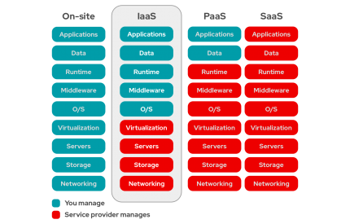

Slide 31
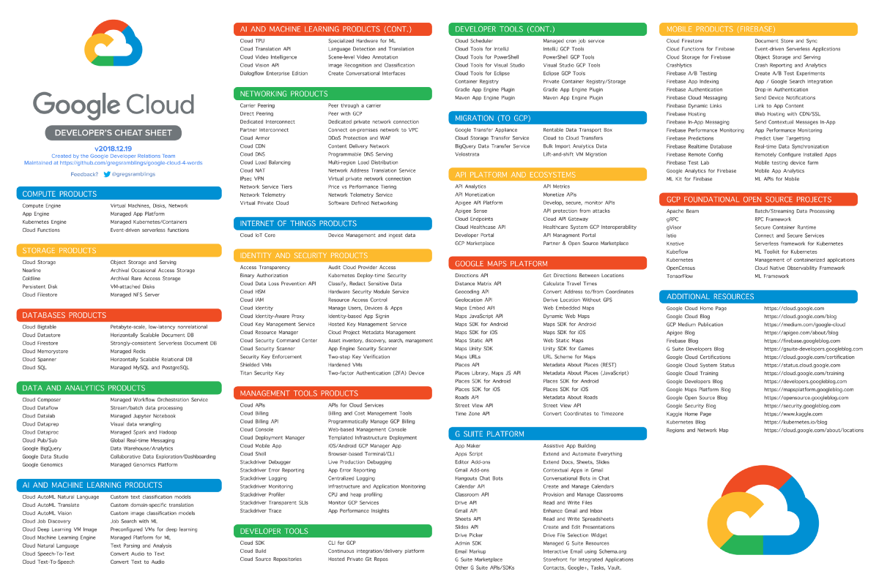

Slide 32
Unit - II
Virtualization Introduction, Characteristics of Virtualized Environments, Taxonomy of Virtualization Techniques, Execution Virtualization, Types of hardware virtualization: Full virtualization - partial virtualization - para virtualization
Desktop virtualization: Software virtualization – Memory virtualization - Storage virtualization – Data Virtualization – Network virtualization, Virtualization and Cloud Computing, Pros and Cons of Virtualization, Technology Examples, Xen: Para virtualization, VMware: Full Virtualization, Microsoft Hyper-V.

Slide 33
Virtualization in Cloud Computing and Types
Virtualization is a technique of how to separate a service from the underlying physical delivery of that service.
It is the process of creating a virtual version of something like computer hardware.
It was initially developed during the mainframe era. It involves using specialized software to create a virtual or software-created version of a computing resource rather than the actual version of the same resource.
With the help of Virtualization, multiple operating systems and applications can run on same machine and its same hardware at the same time, increasing the utilization and flexibility of hardware.

